Slide 1
Advanced Indicator Calculations
Jim Grace
Scott Russpatrick
jim@dhis2.org
scott@dhis2.org
DHIS2 Annual Conference
June 12, 2024

Slide 2
Advanced Indicator Calculations
Data Quality use-case
B. Other advanced indicator features

Slide 3
A. Data Quality Use-case
Data element reporting rates
Facility reporting consistency
Outlier impact

Slide 4
Data element reporting rates
Data set completeness and timeliness are useful measures to monitor the overall reporting performance of the system. However, there are several conditions that needs to be met for the data set completeness to give a representative indication of completeness of the data within the data set:
Users must remember to mark the data set as complete when data has been entered
User must actually enter data in the form before marking it as complete
Assignment of data set to orgunits (facilities) must be correct
Often, one or more of these conditions are not met, which means that it is necessary to also do additional analysis of the reporting completeness. In this section we show
How to analyse the proportion of facilities that consistently report data element values over a time period, and
How to analyse completeness of an individual data element
Common for the approaches outlined is that they require us to configure additional metadata for each variable we want to assess. In practice, this means that they can only be implemented for a limited set of data elements. The implementation section discusses this further.

Slide 5
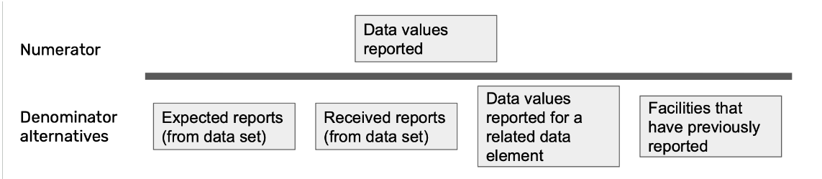
Data element reporting rates
1 2 3 4

Slide 6
Data Values reported for a related data value (Option 3)
Based on data element in the same data set
This option is similar to the above, but using a data element reported in the same data set or data set section as the data element you are calculating the reporting rate for (numerator) - without necessarily being logically related. With this approach, you should choose a data element that is always (or often) reported on in the data set. For example, in a data set with maternal health data, more health facilities will likely report on a data element for “Antenatal care first visits” than for “Assisted delivery”, and “Antenatal care first visits” would therefore be a better estimation of the number of expected reports.
Based on core indicator
If the data element you want to get a reporting rate for is used in a key performance indicator calculation with routinely reported data in the denominator, using the count of values reported for the denominator to calculate completeness is recommended. This option is not viable if the data element is not used in an indicator calculations, or if the denominator is based on a population estimate or other value that is not reported with the same periodicity as the numerator.
As an example, consider the indicator Suspected cases tested for Malaria (%):
100 x (Malaria tested cases / Suspected cases)
In this case, it can be useful to look at the completeness of Malaria cases tested with the count of Suspected cases as denominator.
The advantage of this option is that it gives a good indication of the completeness/consistency of data used to calculate a particular core indicator.
Based on related data element
This option is similar to the above, but using a data element that is closely related to the data element in the numerator to calculate the denominator. For example, if you are looking at a reporting rate for inpatient malaria cases under 5 years (numerator), then you might consider using the count of inpatient malaria cases 5 years and above, inpatient malaria deaths, outpatient malaria cases or similar as denominator.

Slide 7
Data Values reported for a related data value (Option 4)
The final option is to use the count of facilities that have reported on the data element previously, within a given time frame, as denominator. This is similar to the denominator used for the indicator on “facilities consistently reporting.” This can be a good estimation of the number of expected reports, in particular in cases where data set assignment is not accurate: if a facilities has reported on a particular data element previously, it typically means the the facility is providing whatever service/diagnostic the data element represents and one can expect it should report on it routinely. However, the results should still be analyzed together with the overall data set completeness since it will not include facilities that are supposed to report, but have not done so in the given time period.
To calculate the count of times an orgunit has reported on the data element you are assessing in any of the previous last 12 months, we must use a predictor and extra data element. This is the same calculation as for the denominator described above in the section on Orgunits consistently reporting. In summary, a predictor with a generator
if(isNotNull([data element]**), 1, 0) **
and sequential sample count set to the number of previous periods you want to assess will produce the count to use as denominator.

Slide 8
Data Element reporting completeness with disaggregation
One specific category option combination. For example, “reported” means having reported for “BCG doses < 1 year”.
Both category option combinations. For example, “reported” means having reported for “BCG doses < 1 year” and “BCG doses >=1 year”.
Either of category option combination. For example, “reported” means having reported for “BCG doses < 1 year” or “BCG doses >= 1 year”

Slide 9
Indicator subExpression for data element completeness
Data element completeness metric: | predictors | indicators with subExpressions since
Data element with no disaggregation, in one period | ✓ | 2.38.1
Data element with disaggregation - analysis of one category option combo, in one period | ✓ | 2.38.1
Data element with disaggregations - counting each category option combo with a value as “reported”, in one period | ✓ | 2.38.1
Data element with disaggregation - all category option combos must have value for data element to be “reported”, in one period | ✓ | 2.40
Any of the above present in any of several periods | ✓ | 2.40.2
Any of the above present in all of several periods | ✓ | 2.40.2
Any of the above in a given fraction fraction of several periods | ✓ | 2.40.2

Slide 10
What is an indicator subExpression?
A subExpression evaluates within each organisation unit
before aggregating across organisation units
subExpression history:
2.38.1 | Initial implementation, operates on each data value independently → Can only reference one data element or data element / disaggregation
2.40 | Major rewrite, operates on all data values within an organisation → Can reference multiple data elements or data element / disaggregations
2.40.2 | Significant new feature allows .periodOffset() inside the subExpression → Can also reference past (or future!) periods inside the subExpression

Slide 11
subExpression inside aggregation
within subExpression (within organisation unit):
numeric data: data element aggregation type "within organisation units"
non-numeric data: uses MAX
but can override:
subExpression( #{vq2q03TrNi}.aggregationType(AVERAGE) )

Slide 12
subExpression outside aggregation
outside subExpression (across organisation units):
uses SUM across organisation units
but can override:
subExpression( #{URtu9deexeo} ).aggregationType(MIN)

Slide 13
Facility reporting consistency – building blocks
if(isNotNull(#{data_element_uid}), 1, 0) produces 1 if a value exists, 0 otherwise
if(#{data_element_uid}==4,1,0) produces 1 if the value is 4, and 0 otherwise
#{data_element_uid}.periodOffset(-1) gives the value from the previous period
#{data_element_uid}.periodOffset(-2) gives the value from two periods earlier
#{data_element_uid}.aggregationType(COUNT) count of values (not sum, avg, etc.)

Slide 14
Facilities with all disaggregations entered
for the past 12 months
subExpression(if(#{P3jJH5Tu5VC}.periodOffset(-1)==4
and #{P3jJH5Tu5VC}.periodOffset(-2)==4
and #{P3jJH5Tu5VC}.periodOffset(-3)==4
and #{P3jJH5Tu5VC}.periodOffset(-4)==4
and #{P3jJH5Tu5VC}.periodOffset(-5)==4
and #{P3jJH5Tu5VC}.periodOffset(-6)==4
and #{P3jJH5Tu5VC}.periodOffset(-7)==4
and #{P3jJH5Tu5VC}.periodOffset(-8)==4
and #{P3jJH5Tu5VC}.periodOffset(-9)==4
and #{P3jJH5Tu5VC}.periodOffset(-10)==4
and #{P3jJH5Tu5VC}.periodOffset(-11)==4
and #{P3jJH5Tu5VC}.periodOffset(-12)==4,1,0).aggregationType(COUNT))

Slide 15
Facilities with all disaggregations entered
for at least 10 of the past 12 months
subExpression(if(
if(#{P3jJH5Tu5VC}.periodOffset(-1)==4,1,0)
+ if(#{P3jJH5Tu5VC}.periodOffset(-2)==4,1,0)
+ if(#{P3jJH5Tu5VC}.periodOffset(-3)==4,1,0)
+ if(#{P3jJH5Tu5VC}.periodOffset(-4)==4,1,0)
+ if(#{P3jJH5Tu5VC}.periodOffset(-5)==4,1,0)
+ if(#{P3jJH5Tu5VC}.periodOffset(-6)==4,1,0)
+ if(#{P3jJH5Tu5VC}.periodOffset(-7)==4,1,0)
+ if(#{P3jJH5Tu5VC}.periodOffset(-8)==4,1,0)
+ if(#{P3jJH5Tu5VC}.periodOffset(-9)==4,1,0)
+ if(#{P3jJH5Tu5VC}.periodOffset(-10)==4,1,0)
+ if(#{P3jJH5Tu5VC}.periodOffset(-11)==4,1,0)
+ if(#{P3jJH5Tu5VC}.periodOffset(-12)==4,1,0)
>= 10,1,0).aggregationType(COUNT))

Slide 16
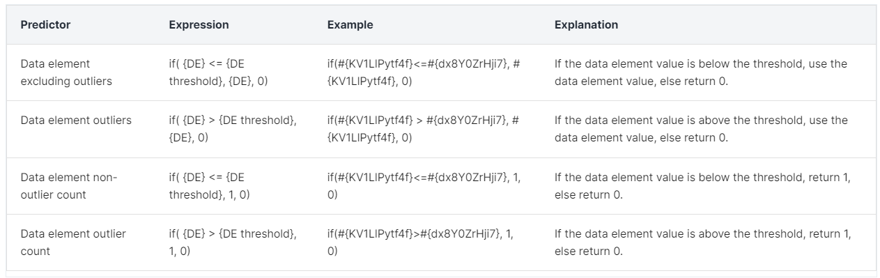
Outlier impact
Outlier threshold expression for a predictor: avg({data_element_uid}) + (3 * stddevPop({data_element_uid}))
Indicator

Slide 17
Outlier calculations
Percentage of values that are outlier values for a particular data element:
Numerator: count of outlier values
Denominator: all values for the data element
Factor: 100
Purpose: metric of the data quality, and can be used to look at geographical comparisons or changes over time
Value excluding outliers as a percentage of the overall value for a particular data element:
Numerator: the values for the data element that are not outliers
Denominator: all values for the data element
Factor: 100
Purpose: metric for the significance the outlier values has on the overall value for a data element, and can be used both for time trends and geographical comparisons. Also gives an indication of how significantly outliers affect the overall data which is an important consideration when analyzing data.

Slide 18
B. Other advanced indicator calculations
New this year
Other notable indicator syntax

Slide 19
New indicator syntax since June 2023
periodOffset in subExpression – since 2.40.2 DHIS2-15874
subExpression(#{P3jJH5Tu5VC} + #{P3jJH5Tu5VC}.periodOffset(-1))
counting boolean values in subExpression – since 2.40.3 DHIS2-15936
subExpression(#{LHXqz53TmPe}.aggregationType(COUNT))
using nested indicators with periodOffset – since 2.40.3, 2.39.5, 2.38.7 DHIS2-15434
N{AUqdhY4mpvp} + N{AUqdhY4mpvp}.periodOffset(-1)
contains and containsItems for multi-select (and text) data elements – since 2.41 DHIS2-16211
contains(#{uid},'ALLERGY') – matches any substring
containsItems(#{uid},'LATEX_ALLERGY','MOLD_ALLERGY') – matches whole items
comments – since 2.41 DHIS2-15035
#{fbfJHSPpUQD} /* ANC 1st visit */

Slide 20
Other notable indicator syntax (1 of 2)
if() Returns values depending on whether test is true or false
is([value] in …) Is value equal to any of several values
isNull() Returns true if a value is absent (null)
isNotNull() Returns true if a value is present (not null)
firstNonNull() Returns first non-null value from a variable number of values
null A null value
removeZeros() Same logic as if(value == 0, null, value)

Slide 21
Other notable indicator syntax (2 of 2)
greatest() Greatest of a variable number of values
least() Least of a variable number of values
.minDate() Return data on or after a start date
.maxDate() Return data on or before an end date
.yearToDate() Sums data from start of calendar year
[periodInYear] Index of the reporting period in the calendar year
[yearlyPeriodCount] Number reporting periods in the calendar year
[days] Number of days in the reporting period

Slide 22
Advanced Indicator Calculations
The end!
Jim Grace
Scott Russpatrick
jim@dhis2.org
scott@dhis2.org
DHIS2 Annual Conference
June 12, 2024

Slide 23
Advanced Indicator Calculations
Extra content
Jim Grace
Scott Russpatrick
jim@dhis2.org
scott@dhis2.org
DHIS2 Annual Conference
June 12, 2024

Slide 24
Annualized indicators are not ideal
Numbertor: BCG doses given <1 yr
Usually captured monthly
X
12 (annualized tick box)
Denominator: Live births or Target
Usually captured annually; alternative denominators may include 'live births' reported routinely from health facilities and/or community sources
Assumes values each month are similar.

Slide 25
Period offset coverage indicators
This Month BCG coverage:
June + May + April + March + February + January + December + November + October + September + August + July
Annual Live births or Annual Targets
More accurate. Uses actual values!

Slide 26
.periodOffset()
since 2.35
Example 1: Find the change from last month to this month
#{DiexouTeWi8} - #{DiexouTeWi8}.periodOffset(-1)
Example 2: Rolling annual count – current month plus last 11 months
#{WSy7zOZx1Wl} + #{WSy7zOZx1Wl}.periodOffset(-1) + #{WSy7zOZx1Wl}.periodOffset(-2) + #{WSy7zOZx1Wl}.periodOffset(-3) + #{WSy7zOZx1Wl}.periodOffset(-4) + #{WSy7zOZx1Wl}.periodOffset(-5) + #{WSy7zOZx1Wl}.periodOffset(-6) + #{WSy7zOZx1Wl}.periodOffset(-7) + #{WSy7zOZx1Wl}.periodOffset(-8) + #{WSy7zOZx1Wl}.periodOffset(-9) + #{WSy7zOZx1Wl}.periodOffset(-10) + #{WSy7zOZx1Wl}.periodOffset(-11)

Slide 27
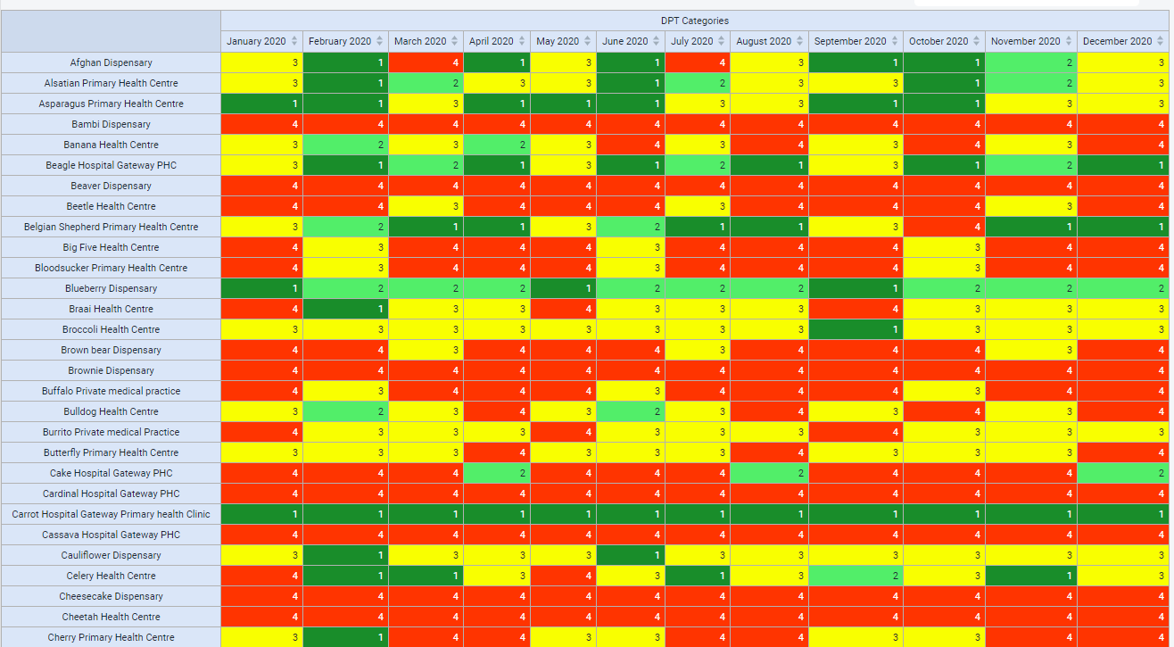
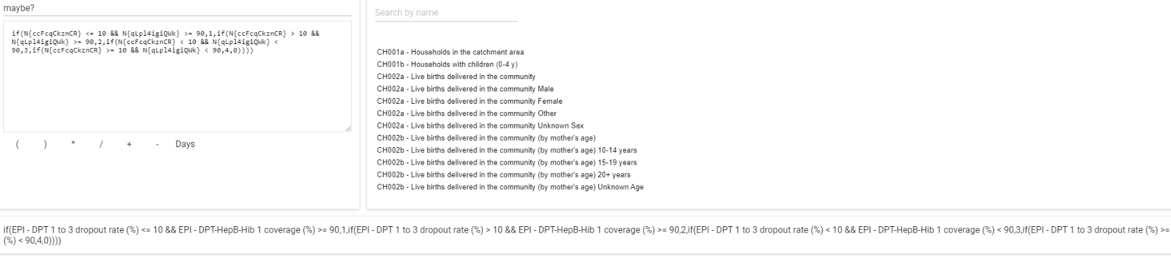
EPI Categories
Relationship between DPT 1 to 3 dropout rate and DPT coverage
Category 1: Cov >= 90 & DR <=10
Category 2: Cov >= 90 & DR > 10 Category 3: Cov < 90 & DR < 10
Category 4: Cov < 90 & DR >= 10

Slide 28
if
since 2.34
if( test, resultIfTrue, resultIfFalse )
Example 1: return 1 if positive, else 0
if( #{Emah4iezieW} > 0, 1, 0 )
Example 2: EPI Categories relating dropout rate and coverage
if(N{ccFcqCkznCR} <= 10 && N{qLpl4igiQWk} >= 90, 1, if(N{ccFcqCkznCR} > 10 && N{qLpl4igiQWk} >= 90, 2, if(N{ccFcqCkznCR} < 10 && N{qLpl4igiQWk} < 90, 3, if(N{ccFcqCkznCR} >= 10 && N{qLpl4igiQWk} < 90, 4, 0) ) ) )

Slide 29
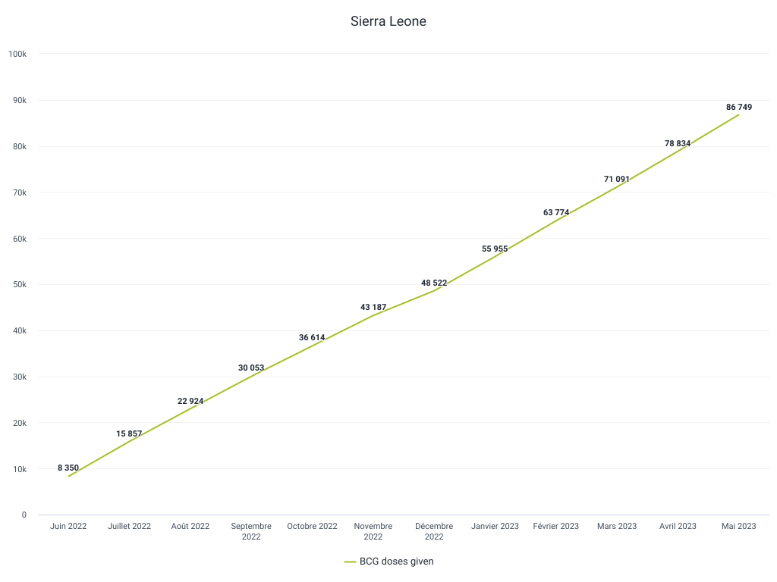
.yearToDate
indicators since 2.39
How do you know if you are on track to deliver your vaccination targets for the year?

Slide 30
.yearToDate
indicators since 2.39
Sums data within calendar year
Example 1: Sum year to date
#{gaph0mia8Io}.yearToDate()
Example 2: Average year to date
#{gaph0mia8Io}.yearToDate() / [periodInYear]
Example 3: Expected year to date (e.g. 1/12th of population each month)
#{TYaw1AiBa7x} * [periodInYear] / [yearlyPeriodCount]

Slide 31
Advanced Indicator Calculations
End of extra content
Jim Grace
Scott Russpatrick
jim@dhis2.org
scott@dhis2.org
DHIS2 Annual Conference
June 12, 2024

